Slide 1
Guide to GUIs

Slide 2
Getting Started

Slide 3
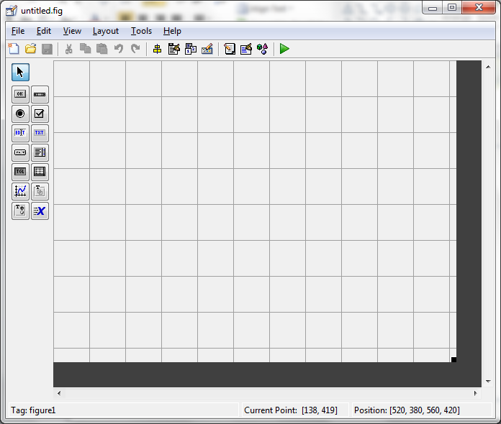
Creating a GUI
At the command prompt, type >> guide
Select Create New GUI - Blank GUI (Default)
Drag and Drop all the components you wish to use into the layout.

Slide 4
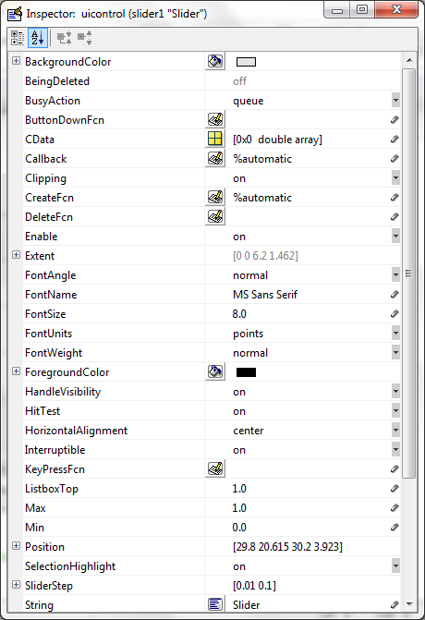
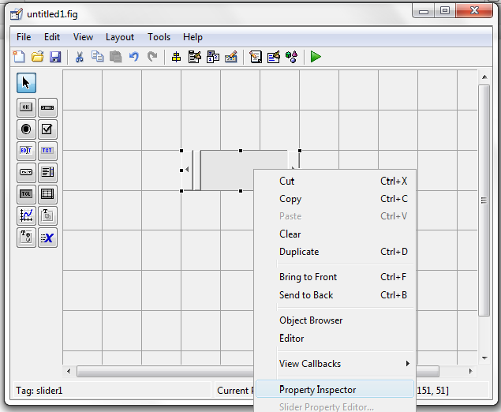
Creating a GUI
Right click on any component to open the property inspector

Slide 5
Creating a GUI
Set the desired properties of your components using the Property Inspector (tag, string, …). Refer to the components section in this presentation for more detail on the key properties for specific components.
Pick good names for the tag of your components.
The tag is how you will access this component
The tag must start with a letter (just like variable names)
The tag should reflect what the component’s function is.
The tag should be easy to remember
The tag must be unique – don’t use it for any other component or as a variable name in your program

Slide 6
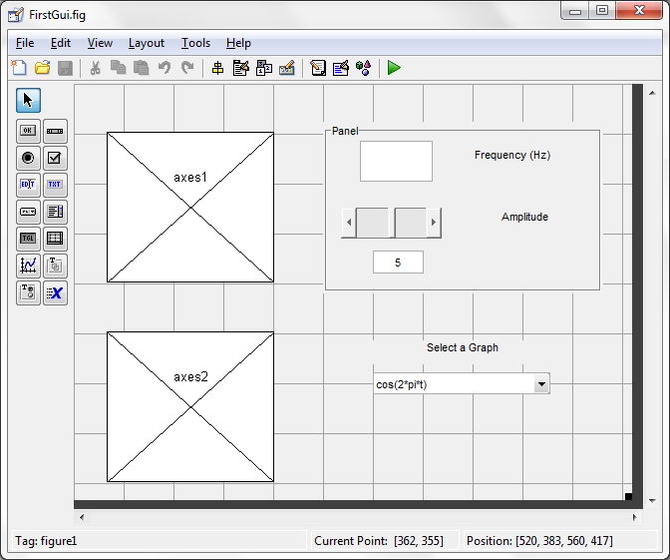
Creating a GUI
Once you have set up all of your components, click on the green play button to launch the gui and create an m-file for your GUI.
The first time you do this, you will be prompted for a file name for your GUI

Slide 7
Programming a GUI

Slide 8
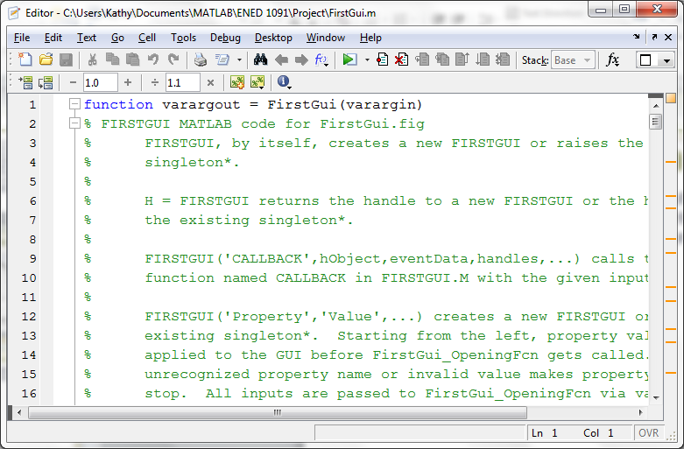
Programming a GUI
When you activate your GUI (green play button), two files will be created. One is a .m file where you can write code for your GUI. Any executable MATLAB commands will run in a GUI. The other file is a .fig file.

Slide 9
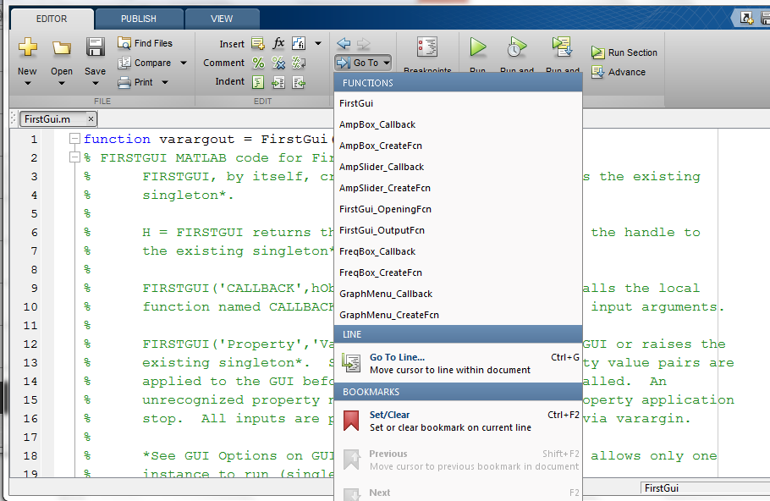
Programming a GUI
If you click on the blue Go To Arrow, you get a list of functions already in your program corresponding to your components.
Clicking on one of the functions on this list takes you directly to that function (better than scrolling!)

Slide 10
Programming a GUI
Almost every component that you put in your GUI layout, will get a callback function in your program. Your program will go to the callback function for a component every time the user interacts with that component.
For example, if you have a slider and a user moves the slider, your program will go to the callback function for the slider. In that callback function, you can write whatever you want to happen when the user moves the slider (using executable MATLAB statements).

Slide 11
Programming a GUI: Key Commands
The get command allows you to retrieve any property of any component in your GUI.
The set command allows you to set any property of any component in your GUI.

Slide 12
Debugging Your Program
Use the same techniques to debug your GUI program that you use to debug any function that you write.
Leaving off semicolons will cause the outputs of those lines of code to appear in the command window
Setting breakpoints will allow you to track through your program and see what your variables are.

Slide 13
Components

Slide 14
Static Text Boxes
Static Text Boxes are used as labels.
The two properties you really care about are the tag (identifies the box) and string (what is written in the box). These can be set up using the Property Inspector in guide.
A User cannot change what is written in a Static Text Box – only the programmer can control the contents.
It is possible to change the string in a static text box within the GUI program: Suppose you have a static text box with a tag Text1
set(handles.Text1,’String’,‘Frequency’) will replace whatever is in the static text box with the word, Frequency.

Slide 15
Edit Text Boxes
Edit Text Boxes are Boxes that allow the user to enter information.
The key properties are the tag (identifies the box) and the string (what is written in the box).
You can use the property inspector in the guide layout to write whatever you want to appear in the box when your GUI starts.
In the call back function for an edit text box, you write MATLAB code for whatever you want to happen when the user enters something into the box.

Slide 16
Edit Text Boxes: Retrieving Content
If you are expecting a number in a box with a tag, Box1, you can access that number with the command:
Number = str2double(get(handles.Box1,’String’))
If you are expecting an equation to be entered in the box with a tag, Box1, you can access that equation with the command:
Func = sym(get(handles.Box1,’String’)
If you are expecting a string to be entered in the box with a tag, Box1, you can access the string with the command:
Text = get(handles.Box1,’String’)

Slide 17
Writing to an Edit Text Box
You can also write into an Edit Text Box. Suppose you have an Edit Text Box with a tag of Box1.
The command: set(handles.Box1,’String’,’Frequency’)
will write the text, Frequency, into Box1.
The command: set(handles.Box1,’String’,10)
will write the number, 10, into Box1.
The commands:
func = sym(‘cos(2*t’);
set(handles.Box1,’String’,char(func))
will write the symbolic function, cos(2*t), into Box1.

Slide 18
Writing to an Edit Text Box
You can also use sprintf to add formatted strings to static and edit boxes. Works exactly the same as an fprintf command but works for GUIs:
message = sprintf(‘…..’, variable list)
set(handles.Box1,’String’,message)
For example:
V = 23.5174; A = 14.2;
message = sprintf(‘V = %0.4f and A = %0.1f’,V,A)
set(handles.Box1,’String’,message)

Slide 19
Enable and Visible Properties
All components have Enable and Visible Properties. Suppose you have an Edit Text Box with a tag of Box1.
The command: set(handles.Box1,’Enable’,’off’)
will disable Box1 so your user can’t write into it.
The command: set(handles.Box1,’Enable’,’on’)
will enable Box1 so the user can write into it.
The command
set(handles.Box1,’Visible’,’off’)
will make Box1 disappear.
The command
set(handles.Box1,’Visible’,’on’)
will make Box1 reappear.

Slide 20
Push Buttons
The key properties for a pushbutton are:
Tag: identifier or name of the push button
String: text written on the button
In the callback function for a push button, you simply write MATLAB code for whatever you want to happen when the user pushes the button.

Slide 21
Sliders
The key properties for a slider are:
Tag: identifier or name of the slider
Max: maximum value for the slider
Min: minimum value for the slider
Value: value of the slider (must be in the range [Min Max])
These can all be set up using the Property Inspector when you first create your GUI using guide

Slide 22
Sliders: Retrieving the Value
The Slider Value will change when the user moves the slider back and forth. The Slider value will vary from Min to Max.
Suppose you have a slider tagged Slider1
The command:
SliderValue = get(handles.Slider1,’Value’)
will retrieve the value of the slider.

Slide 23
Pop-Up Menus
The key properties for a pop-up menu are:
Tag: identifier or name of the pop-up menu
String: list of choices for the user in the pop-up menu

Slide 24
Pop-Up Menus
Suppose you have a pop-up menu with a tag, Menu1.
Typical code in the Menu1_Callback would be:
choice = get(handles.Menu1,’Value’);
switch choice
case 1 % User Picked First Item on Menu
Desired Code if user picks first item
case 2 % User Picked 2nd Item on Menu
Desired Code if user picks second item
…
end

Slide 25
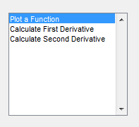
List Box
A List Box is similar to a pop-up menu but it shows all of the choices at one (unless the list is really long in which you get a scroll bar). The key properties for a list box are:
Tag: identifier or name of the list box
String: list of choices for the user shown in the box

Slide 26
List Box
Suppose you have a list box with a tag, ListBox.
Typical code in the ListBox_Callback would be:
choice = get(handles.ListBox,’Value’);
switch choice
case 1 % User Picked First Item on List
Desired Code if user picks first item
case 2 % User Picked 2nd Item on List
Desired Code if user picks second item
…
end

Slide 27
Check Boxes
The key properties for a check box are:
Tag: identifier or name of the pop-up menu
String: text to tell the user what the check box is for
Max: the value of the box when it is checked (default is 1 which should be a perfectly good value)
Min: the value of the box when it is un-checked (default is 0 which again is a perfectly good value)
Value: this will be Max when the user checks the box and Min when the user un-checks the box. Initially (in the Property Inspector) Value is set to 0 so the box is unchecked when the GUI starts. If you change it to 1, the box will be checked when the GUI starts.

Slide 28
Check Boxes
Suppose you have a check box with a tag, CheckBox1. Typical code in the CheckBox1_Callback would be:
choice = get(handles.CheckBox1,'Value');
if choice == get(handles.CheckBox1,'Max')
% User Checked the Box
Desired Code if user checks the box
elseif choice == get(handles.CheckBox1,'Min')
% User Un-Checked the Box
Desired Code if user un-checks the box
end

Slide 29
Radio Buttons and Toggle Buttons
Radio Buttons and Toggle Buttons work the same way as Check Boxes – they just have a different appearance.

Slide 30
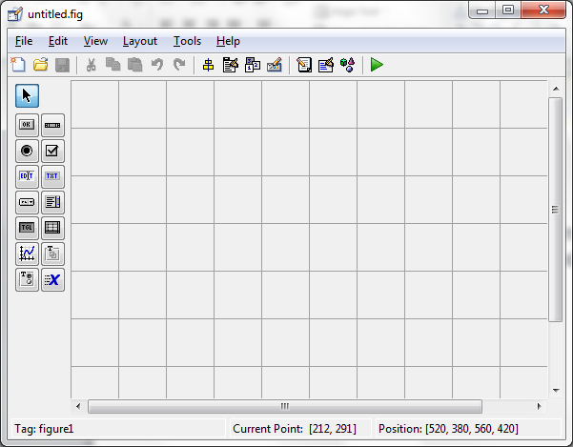
Button Group
A Button Group can be used to put together a group of radio buttons in which only one button can be selected at a time by the user.
First drag and drop a Button Group into the layout.
Then add radio buttons into the button group.

Slide 31
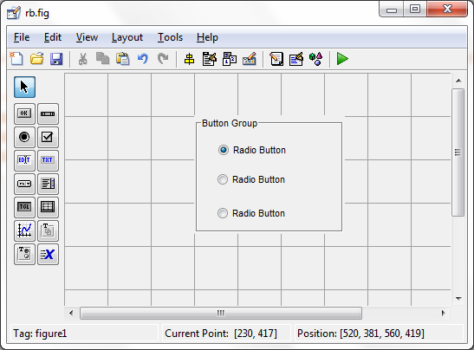
Button Group
The user will only be able to select one of the radio buttons at a time.
Use the Property Inspector to set up the tag and the string (text written next to the button) for each radio button.
You can fill a button group with checkboxes instead of radio buttons. Works exactly the same.

Slide 32
Button Group
Instead of a callback function, button groups use something called a SelectionChangeFcn. For some odd reason, this SelectionChangeFcn doesn’t get created automatically for you like all the Callback functions do. So, you have to create it in the GUI layout (guide) by doing the following:
Right click on the Button Group
Select View Callbacks
Choose SelectionChangeFcn
As soon as you do this, the SelectionChangeFcn will appear in your program allowing you to write code for your Button Group.

Slide 33
Button Group
Suppose you have created a Button Group with three radio buttons. Suppose the tags for these radio buttons are RB1, RB2, and RB3.
Typical code that you might include in the SelectionChangeFnc:
switch get(eventdata.NewValue,'Tag')
% Copy the above line exactly as is!!!
% Gets Tag of selected button in the group.
case ‘RB1'
% Code for when button tagged RB1 is selected
case ‘RB2'
% Code for when button tagged RB2 is selected
case ‘RB3'
% Code for when button tagged RB3 is selected
end

Slide 34
Tables
The key properties for a table are:
Tag: identifier or name of the table
Data: stuff in the table – must be a cell array. Can have some columns with numbers and some columns with strings.
Tables do not automatically have Callback Functions created.

Slide 35
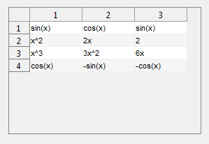
Tables – Adding Contents
Putting these two commands in the opening function of the GUI would create the table shown below (assuming the table has a tag of Table):
Vals = {'sin(x)' 'cos(x)' 'sin(x)'; 'x^2' '2x' '2'; 'x^3' '3x^2' '6x'; 'cos(x)' '-sin(x)' '-cos(x)'};
set(handles.Table,'Data',Vals);

Slide 36
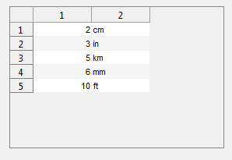
Tables – Adding Contents
Putting these two commands in the opening function of the GUI would create the table shown below (assuming the table has a tag of Table):
Vals = {2 'cm'; 3 'in'; 5 'km'; 6 'mm'; 10 'ft'};
set(handles.Table,'Data',Vals);

Slide 37
Tables – Changing Contents
Putting these commands somewhere in a callback function will allow you to change contents programmically:
Vals = get(handles.Table,'Data');
Vals{1,1} = 17;
set(handles.Table,'Data',Vals);
The commands listed above would simply change the value in the 1st row and 1st column to 17. You could, of course, change several entries or all of the entries in one shot.

Slide 38
Tables – User Entries
It is also possible to set up the table so the user can enter in values. Using guide, right click on the table and choose Table Property Editor. Then check off any columns you want the user to be able to edit.
Then right click on the table in guide, select View Callbacks, and click on CellEditCallback. This will create a callback function so you can tell when a user has changed contents in a cell of the table and do something with the new content.
Consult Product Help in MATLAB for more information on this.

Slide 39
Commonly Asked Questions

Slide 40
How Do I Add, Delete, or Re-size Components?
The original gui layout can be re-opened at any time by typing >>guide and selecting Open Existing GUI.
Make whatever changes you wish then click on the green arrow to activate your changes.
Note: If you delete a component, any code that you have written for that component won’t be deleted in your m-file. This is a nice feature in case you decide to put that component back.

Slide 41
How Do I Make My GUI Go ?
Three ways to do this:
Simply type the filename of your GUI at the command prompt (Example: >> FirstGui)
Open the .m file for your GUI and click on the green activate arrow
Type the command >> guide and open your GUI layout. Then click on the green activate arrow.
Once you are done working on your GUI, the first option makes the most sense. Caution: double clicking on the .fig file will not activate your GUI.

Slide 42
What is handles?
handles is a structure. Think of it as a database that houses all the properties of all of the components in your GUI.
Through handles, you can get or set any property of any component in your GUI.
For example, if you have a slider tagged as AmpSlider, you can access the current value of the slider wherever you want to in your program as follows:
SliderValue = get(handles.AmpSlider,’Value’)

Slide 43
How Do I Share Variables I Create?
If you create variables in one Callback function, none of these variables are available to the other Callback functions.
If you want these variables to be shared, they must be added to the handles structure.

Slide 44
How Do I Share Variables I Create?
For example, suppose you have an Edit Text box tagged Box1 and the user is supposed to enter in an equation.
The following commands will retrieve the equation as a symbolic, take a derivative and integral of the equation, and add the results to the handles structure:
handles.func = sym(get(handles.Box1,’String’));
handles.derivative = diff(handles.func);
handles.integral = int(handles.func);
guidata(hObject,handles); % UPDATE HANDLES
Now, anywhere in your program, you can refer to handles.func, handles.derivative, and handles.integral.

Slide 45
How Do I Change the Name of my GUI?
To change the name of your GUI:
Re-open the GUI using >> guide
Click on Save As and enter your desired filename
This will create a new .m file and a new .fig file with your desired filename.
Caution: Do not right click on the files and attempt to re-name them. This will disable your GUI. If this happens to you, rename the files back to the original name.

Slide 46
How Can I Re-size My GUI so it Looks Right on Other Computers?
If you find that your GUI fits just fine on one computer but doesn’t show up right on another computer, do the following:
Re-open your GUI using >> guide
Click on Tools and Select GUI Options
Change Re-size Behavior from Non-resizable to Proportional. Click on OK
Click on Save

Slide 47
Can I Add Images to my GUI?
Yes.
Make sure your image file(s) are in the same directory as your GUI files.
In the opening function for your GUI, add the image(s) to the handles structure using imread: handles.pic1 = imread(‘filename.ext‘)
Suppose you have an axes with a tag, axes1. The following commands will show the image in axes1:
axes(handles.axes1); cla;
imshow(handles.pic1);

Slide 48
Can I Add Sound to my GUI?
Yes.
Make sure your audio file(s) are in the same directory as your GUI files.
In the opening function for your GUI, add the audio file(s) to the handles structure as follows:
[y, Fs] = audioread(‘filename');
% Reads audio file
handles.song1 = audioplayer(y,Fs);
Wherever you want to play the sound file:
play(handles.song1) % Plays the sound clip
stop(handles.song1) % Stops the sound clip

Slide 49
Common Errors

Slide 50
Common Errors
The usual syntax errors and spelling errors that create problems in writing any program. Learn to spell handles!
Using the same name for a tag and for a variable. For example, if you have an edit box that has a tag, Amplitude, don’t use Amplitude as a variable name in your program.
Don’t end the individual callback functions. If you do, all functions underneath won’t be recognized – you’ll get a red line under all remaining functions. Of course, you do have to include end statements for all conditional statements and loops.

Slide 51
Common Errors
Double clicking on the .fig file will not activate your GUI. It will look OK but when you try to do something, you will get errors. You activate your GUI by typing the name of the GUI .m file at the command prompt or by opening the .m file and clicking on the green activate arrow.
If you decide for some reason to re-name your GUI, you cannot do this by simply re-naming the .m and .fig files. You must re-open your GUI using guide, then do a save as with the new name. MATLAB will create a new .m and .fig file with the new name. The .m file will have all of your original code but is adapted to the new name.

Slide 52
Common Errors
In addition to a CallBack Function, each component also generates a Create Function in your m-file. Don’t delete these Create Functions. If you do inadvertently delete one, simply go back to your GUI layout (guide). Right click on the component, select View Callbacks, then click on Create Function. This will put the Create Function back in your m-file.

